Slide 1
High-Level Language Interface
General and Calling Conventions
Inline assembly code
Linking to C/C++ in protected mode
Linking to C/C++ in Real address mode

Slide 2
Introduction
Where convenience and development time are more important than speed or code size
High-level language is used
Assembly language can be used for fine-tuning of such programs to speedup critical sections of code
Control high speed hardware
Memory-resident code
Access non-standard hardware devices
Write platform specific code
Extend the high-level language capabilities
Interface or connection between high-level languages and assembly language

Slide 3
General Conventions
Naming Convention refers to the rules or characteristics regarding the naming of variables and procedures
Memory model used by a program determines the segment size and whether calls and references will be near or far
Calling Conventions
Refer to the low-level details about how procedures are called
Which registers must be preserved by called procedures
The method used to pass the arguments
Arguments passing order
Whether arguments are passed by value or by reference
How the stack pointer is restored after a procedure call
How functions return values to the calling program

Slide 4
General Conventions
External Identifiers
Must have compatible naming conventions
A C-compiler adds an underscore to all names
Preserves the case
Segment Names
Segment names must be compatible
Simplified segment directives (.code, .data, .stack) with the segment names produced by most C++ compilers
Memory Models
A calling program and the called procedure must both use the same memory model
Model used in real address and protected address mode

Slide 5
.Model Directive
This directives determines several characteristics of the program
Memory model type
Procedure naming scheme
Parameter passing convention
Syntax is .model memorymodel [, modeloptions]
All models except flat is used in real address mode programming
Only flat model is used in protected mode programming
modeloptions include language specifier
Determines calling and naming conventions for procedures and public symbols

Slide 6
Language Specifiers
STDCALL Specifier
Dictates that procedure arguments be pushed on the stack in reverse order – An example
Also determines how procedure arguments are removed from the stack after a procedure call
A constant operand must be supplied to the RET instruction
The constant is added to ESP after the return address is popped from the stack
STDCALL also modifies exported (public) procedure names by storing them in the format _name@nn
nn indicates the number of bytes used by the procedure parameters
Rounded upwards to a multiple of 4

Slide 7
Language Specifier
C Specifier
Dictates that the procedure arguments are pushed on the stack in reverse order
Removing arguments
A constant is added in the calling program
External procedure names are handled in the same way as STDCALL
PASCAL Specifier
Dictates that procedure arguments be pushed in forward order
Removing arguments: Same as STDCALL
Procedure Name
PASCAL: Procedure name is converted to uppercase

Slide 8
Inline Assembly Code
Inline Assembly Code
Assembly language source code that is inserted directly into high-level language programs
__asm Directive in Microsoft Visual C++ :
Inline assembly code for Microsoft visual C++ running in 32-bit protected mode using flat memory model
Main advantage is simplicity as there are no external linking issues
Suffers from lack of portability
The allowed features when writing inline assembly code
Any instruction for 80x86 instruction set is supported
Register names may be used as operands
Code labels and variables declared outside the __asm block are supported
Numeric constants can be used

Slide 9
Inline Assembly Code Syntax
The PTR operator may be used
EVEN and align directives may be used
The __asm directive
Marks the beginning of a block of assembly language statements or a single statement
__asm statement
__asm{ ; may use either ; or // or */ for ; comments but use C/C++ syntax
statement_1 // preferably for comments
statement_2
…
statement n
}

Slide 10
Inline Assembly Code
// ENCODE2.CPP
#include <iostream.h>
#include <fstream.h>
// Translate a buffer of <count> bytes, using an encryption
// character <eChar>. Uses an XOR operation (ASM function).
const int BUFSIZE = 200;
char buffer[BUFSIZE];
int main()
{
unsigned count; // character count
unsigned short encryptCode;
cout << "Encryption code [0-255]? ";
cin >> encryptCode;
unsigned char encryptChar = (unsigned char) encryptCode
ifstream infile( "infile.txt", ios::binary );
ofstream outfile( "outfile.txt", ios::binary );

Slide 11
Inline Assembly Code
cout << "Reading INFILE.TXT and creating OUTFILE.TXT...\n";
while (!infile.eof() )
{
infile.read(buffer, BUFSIZE );
count = infile.gcount();
__asm {
lea esi,buffer
mov ecx,count
mov al, encryptChar
L1:
xor [esi],al
inc esi
Loop L1
} // asm
outfile.write(buffer, count);
}
return 0;
}

Slide 12
Inline Assembly Code
Limitations of inline assembly code
Data definition directives cannot be used
Assembler operators other than PTR cannot be used
Cannot reference macro directives
Cannot reference segments by name
Register Values
Cannot make any assumptions about register values at the beginning of the asm block
Can modify EAX, EBX, ECX and EDX registers in the line code
Example in-line assembly code
File encryption example
Procedure Call Overhead

Slide 13
Inline Assembly Code
void TranslateBuffer (char * buf,
unsigned count, unsigned char eChar)
{
__asm {
lea esi,buffer
mov ecx,count
mov al, encryptChar
L1:
xor [esi],al
inc esi
Loop L1
} // asm
}

Slide 14
High Level Language Interface
Linking to C++ Programs in Protected Mode
There are two modules
An assembly language module that contains the external procedure
A C++ module that starts and ends the program
Contains the extern qualifier for the assembly language module prototype
Arguments
Arguments are passed by C/C++ programs from right to left as they appear in the argument list
The calling program is responsible for cleaning up the stack

Slide 15
High Level Language Interface
External Identifiers
Specify the C calling convention in the model directive
.model flat, C
Create a prototype for each procedure called from a C/C++ program
FindArray PROTO
Declaring the Function
C/C++ automatically appends an underscore to the beginning of each external identifier
A “C” qualifier should be added in the function declaration to avoid name decoration
name decoration modifies the function name with extra characters that indicate the type of each function parameter

Slide 16
High Level Language Interface
Example program, where a C++ programs calls an Assembly language module
An assembly module can also call a C++ module
Example program file names
findarr_h
maincpp
AsmFindArray.asm

Slide 17
High Level Language Interface
Linking to C/C++ in Real-Address Mode
Embedded applications continue to be written in 16-bit mode
16-bit version of Borland C++ 5.01, MS-DOS as the target operating system and using small memory model
Function Return Values:
16-bit values are returned in AX and 32-bit values in DX:AX
Larger data structures are stored in static data locations and a pointer is returned in AX (32-bit pointer in DX:AX when far pointers are returned)
Setting up a Project:
Create a project in Borland C++ IDE

Slide 18
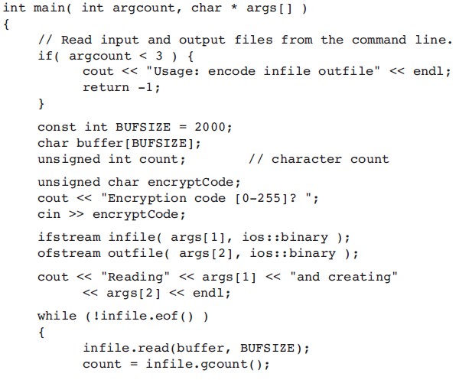
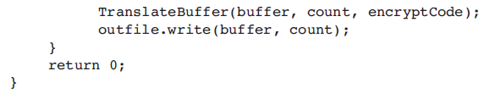

Slide 19

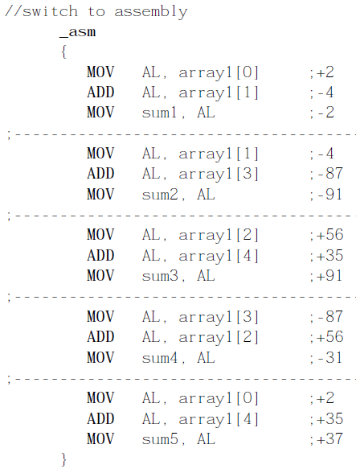
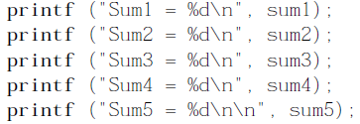
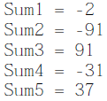

Slide 20
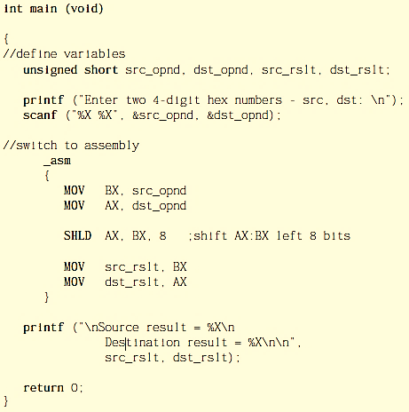
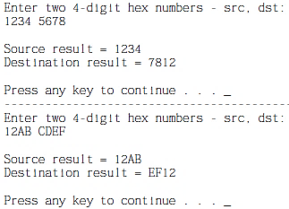

Slide 21
Accessing Input Output Ports directly

Slide 22
Accessing Input-Output Ports
80x86 CPU is capable of addressing 65536 of I/O ports
IN instruction
Inputs a byte or a word from a port
IN accumulator, port
Port may be a constant in the range 0-FFh
For higher port address, DX contains the port number between 0 and FFFFh
Accumulator is the destination
Use AL for 8-bit transfer
Use AX for 16-bit transfer
Use EAX for 32-bit transfer

Slide 23
Accessing Input-Output Ports
OUT instruction
Outputs a byte or a word to a port
OUT port, accumulator
Same rules apply for the OUT instruction as the IN instruction

